Slide 1
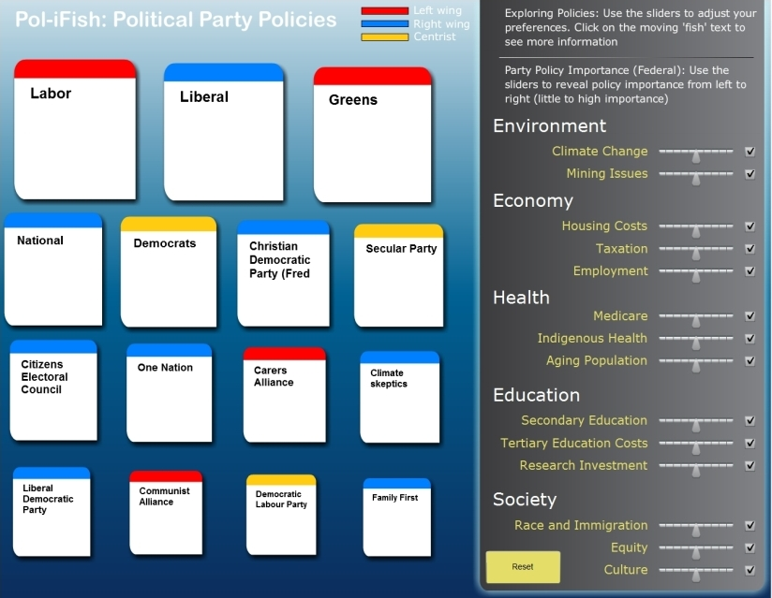
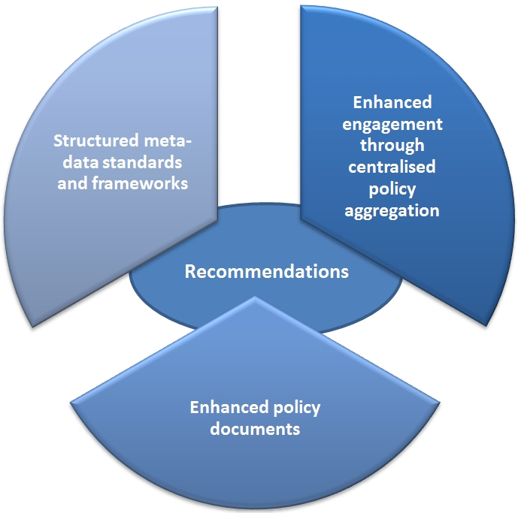
Political Issue Analysis System (PIAS)
Through a series of usability workshops, interviews, and contextual analysis this project explored the evolving applications of online political communication tools and examined user’s searching and ‘deliberative’ processes. The focus of the project was upon environmental and other policy issues and in particular, how users found policy document and contacted their local member. A prototype to aid these practices was developed as well as a report outlining a series of recommendations.
Craig Bellamy (VeRSI)
Martin Gibbs (IS: Uni Melb)
Andy Williamson (Hansard Society: UK)
Sean Cubitt (University of Southampton: UK)
Mitchell Harrop (IS: Uni Melb)
Jaan Kotli (VeRSI)
Background
and do not necessarily aid balanced and deliberative debate. More research needs to be undertaken as to the political effects of the Internet, particularly in terms of deliberate politics and engagement with established political processes in key policy areas. And pressure needs to placed on the parties to allow open-access to policy material that may be aggregated into systems that aid voter decision making.
Key themes and recommendations
The Political Issues Analysis System (PIAS) project sought to investigate how citizens in Melbourne, Australia were using the Internet to seek political information about key political issues. It also sought to understand how citizens contacted their elected representative about these issues. Through workshops, a number of case studies, and the development of a prototype, the research uncovered some notable trends in terms of engagement with the political system online. Email is still the favoured means of contacting elected representatives--and although there are a number of systems being developed to assist online politics--individuals still had a great difficulty in discovering published policies from the major parties in key policy-debate areas. Many of the policies published by the parties exist as political advertisements
One of the key themes that emerged from undertaking the workshops for this study is that citizens find it difficult to locate quality policy information online. Plus there have been few attempts to aggregate the published policies of Australian political parties so that voters may compare and deliberate upon the different policy positions of the parties. This is perhaps a key barrier to the Internet being used constructively by citizens within Australia to engage with formal democratic structures. Some of the key recommendations of this study include:
Polices published by political parties should be made available in such a way that they can be aggregated
Political parties should produce clear, concise, and understandable policy information for the public
PoliFish Prototype developed (above)
Through the workshops undertaken in this study many participants were:
“...surprised how difficult it was to find a wide range of policies in one place to compare. Often had to rely on previous knowledge of Internet + policies in order to have answers” – James
“It was hard to find a website that listed the policies of the different parties in a way that allowed to compare.” - Greg

