Slide 1
Humanities perspectives on digital scholarship
Dual levels of significance in Australian historical data: the case for equilibrium
Dr Craig Bellamy
Analyst Digital Humanities
Secretary: Australasian Association for Digital Humanities

Slide 2
What is historical significance?
What is historical significant data?
What is a ‘dual level of historical significant data? (and why this is important for preservation)

Slide 3
Historical significance
Significance is a debate!
Centred upon a community
Different levels of significance (ie. local, regional, national, international; academic and public communities)

Slide 4
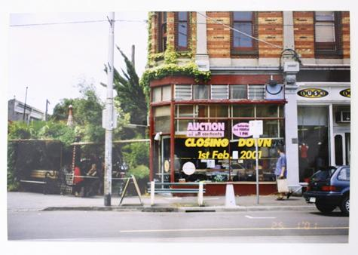

Slide 5


Slide 6
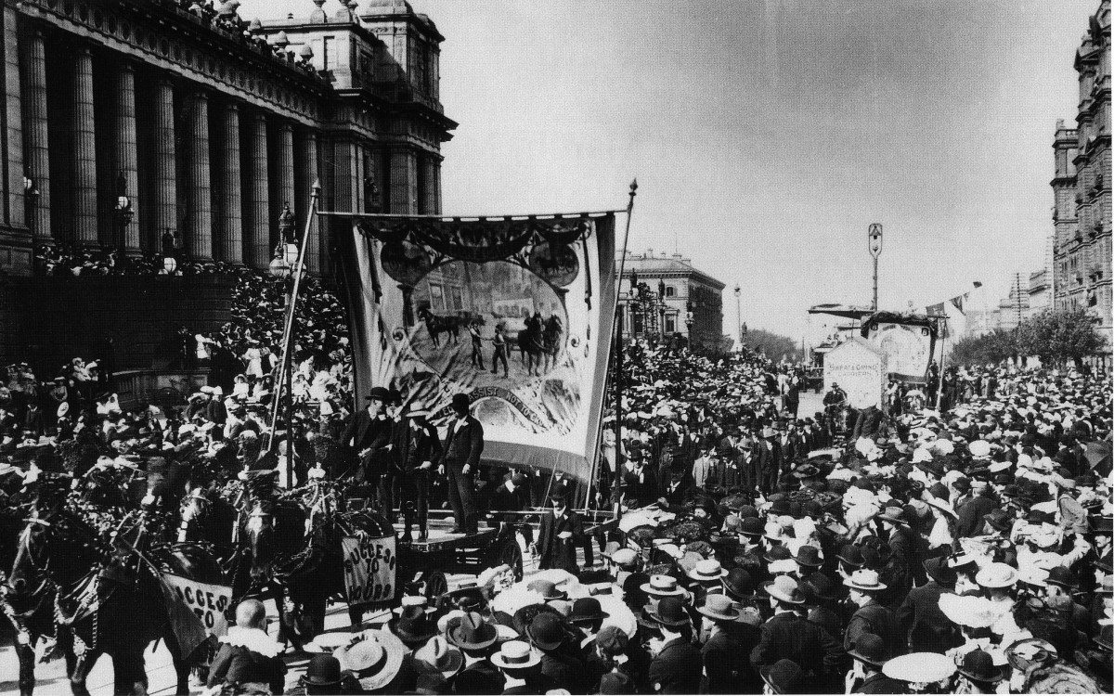

Slide 7
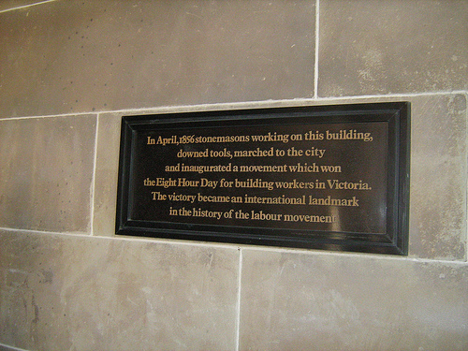

Slide 8
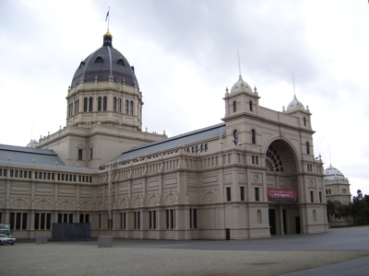

Slide 9
Does digitisation make something more historically significant?

Slide 10
Sometimes...

Slide 11
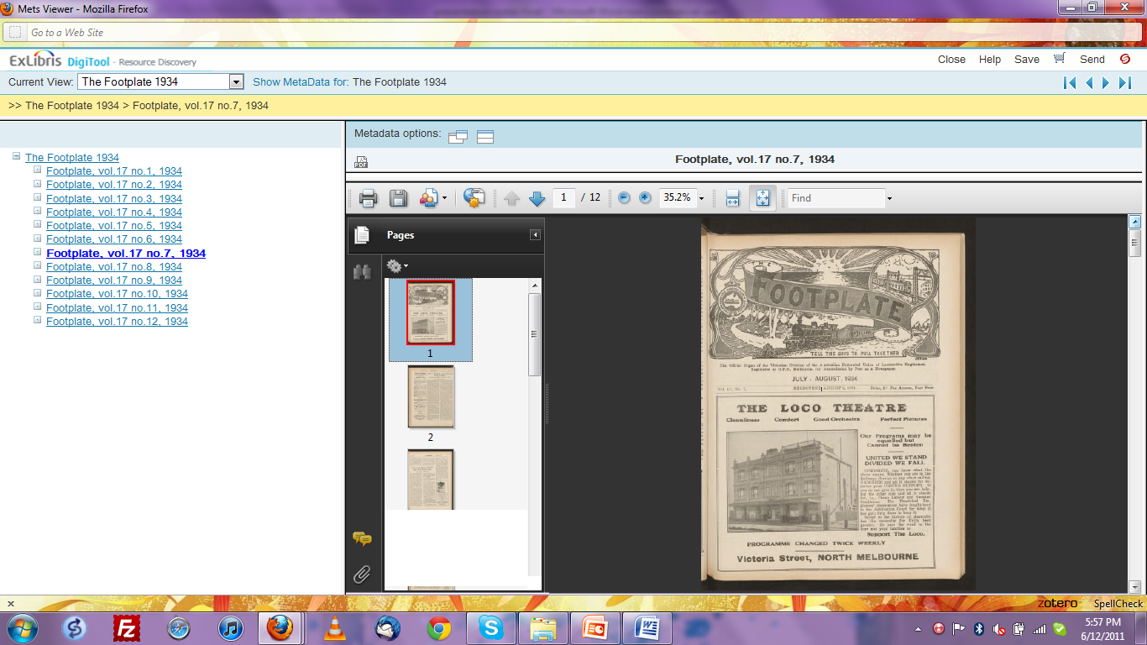

Slide 12
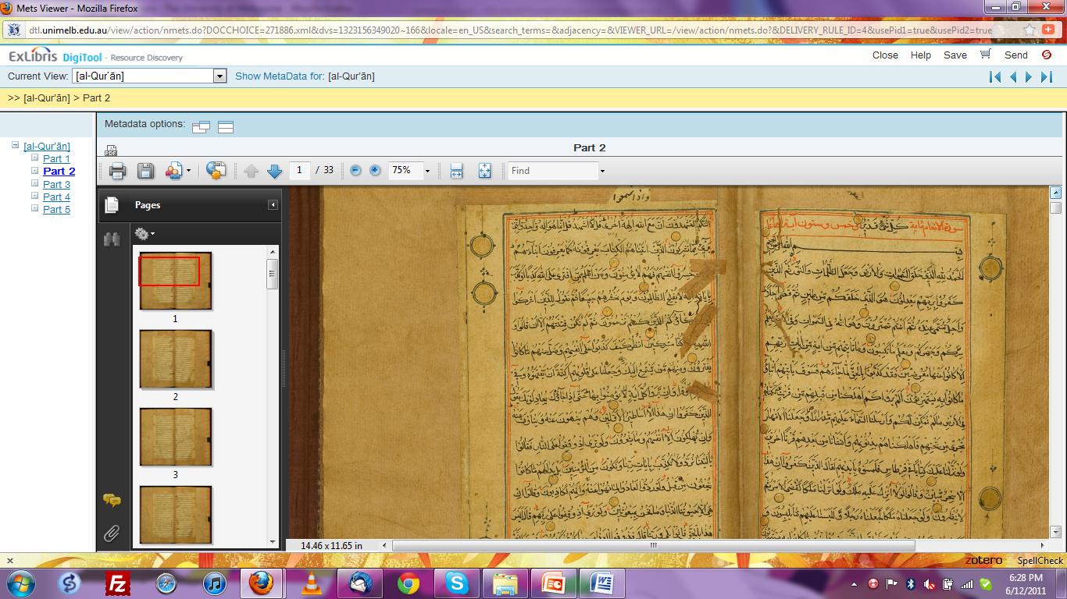

Slide 13
Value-adding...
Locatable (ANDS)
Reusable (Open Data: API, RDF, XML TEI
Machine Readable: data of more value when combined with other data
..and People (the Digital Humanities)

Slide 14
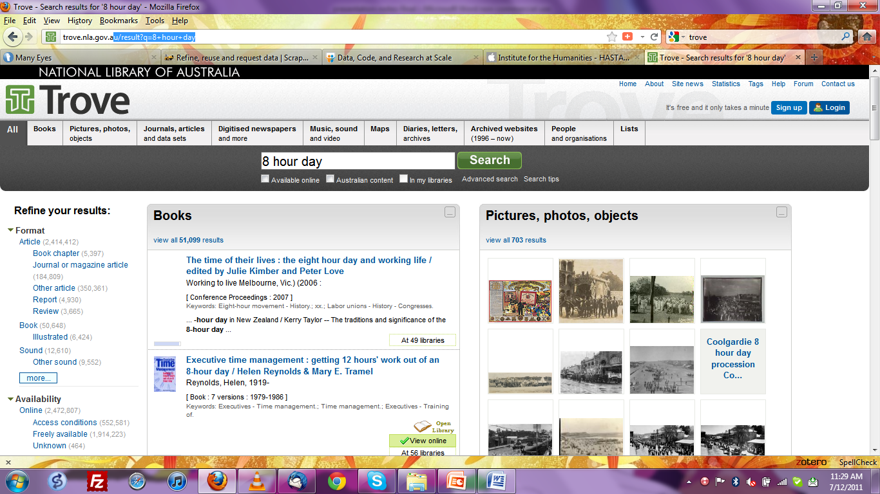

Slide 15
Adding a scholarly layer...
Data doesn’t ‘speak for itself’; it can be secondary or primary evidence about historical phenomena (contextual metadata important)
It doesn't exist outside of interpretation (ie. expert knowledge).Better systems need to be developed to aid re-use and interpretation (ie. facsimile copies often don’t aid in interpretation)

Slide 16
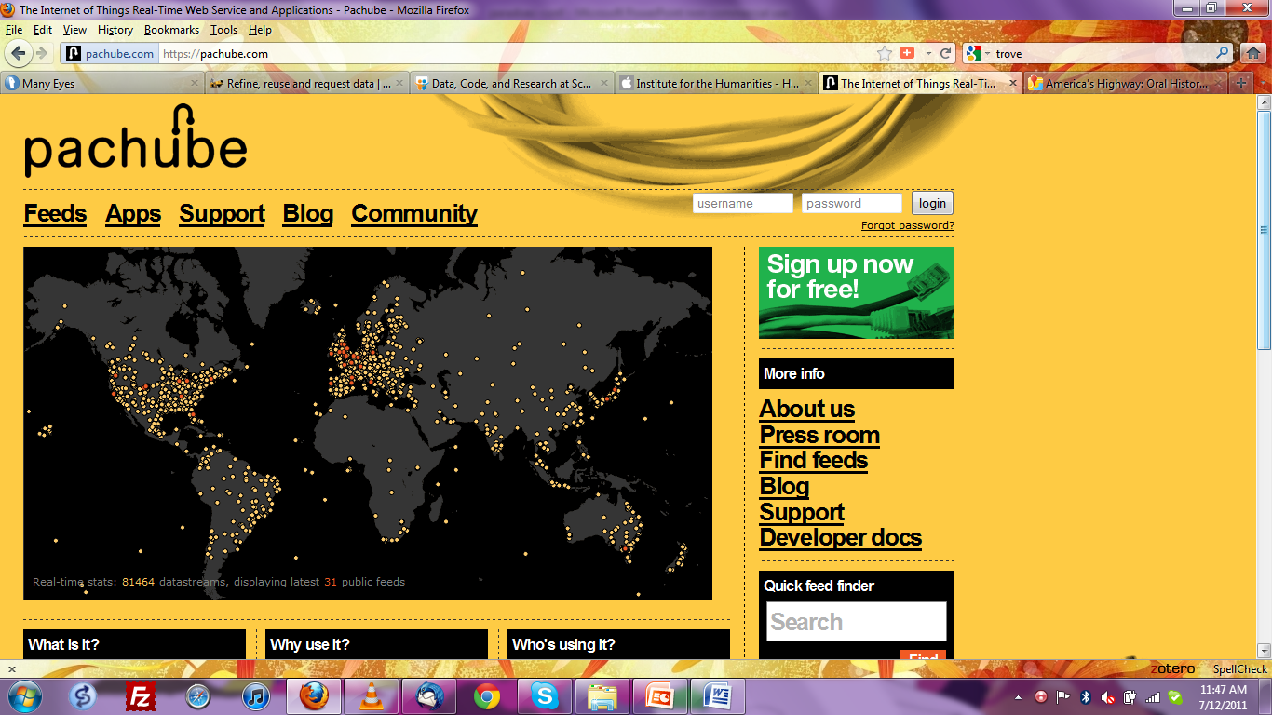

Slide 17
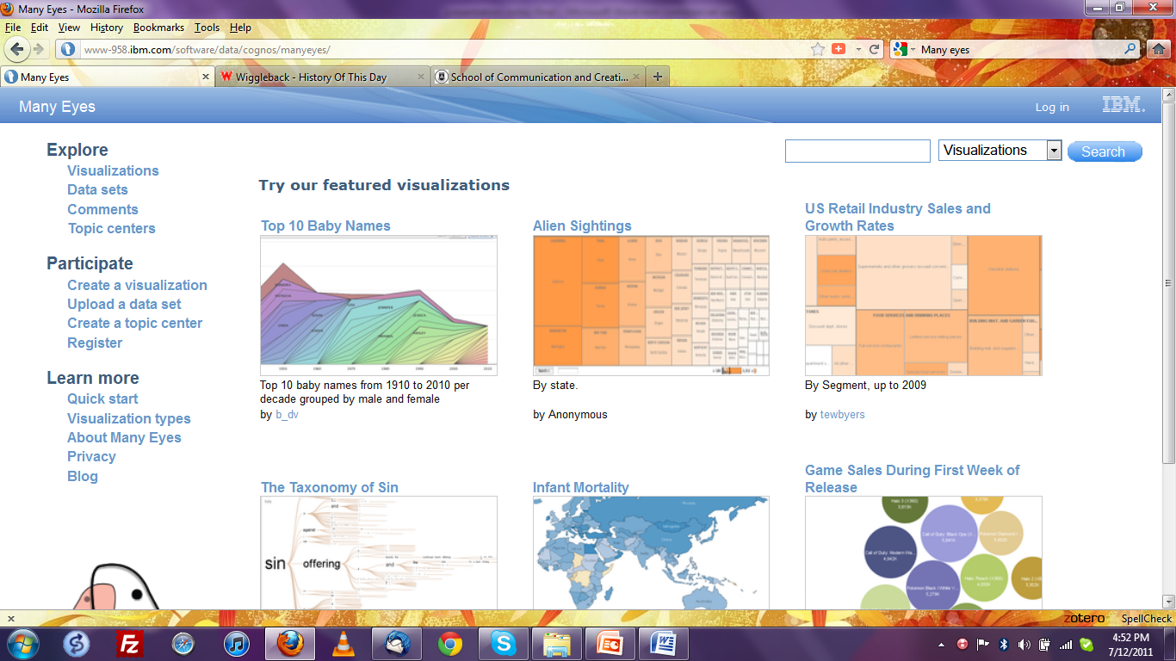

Slide 18
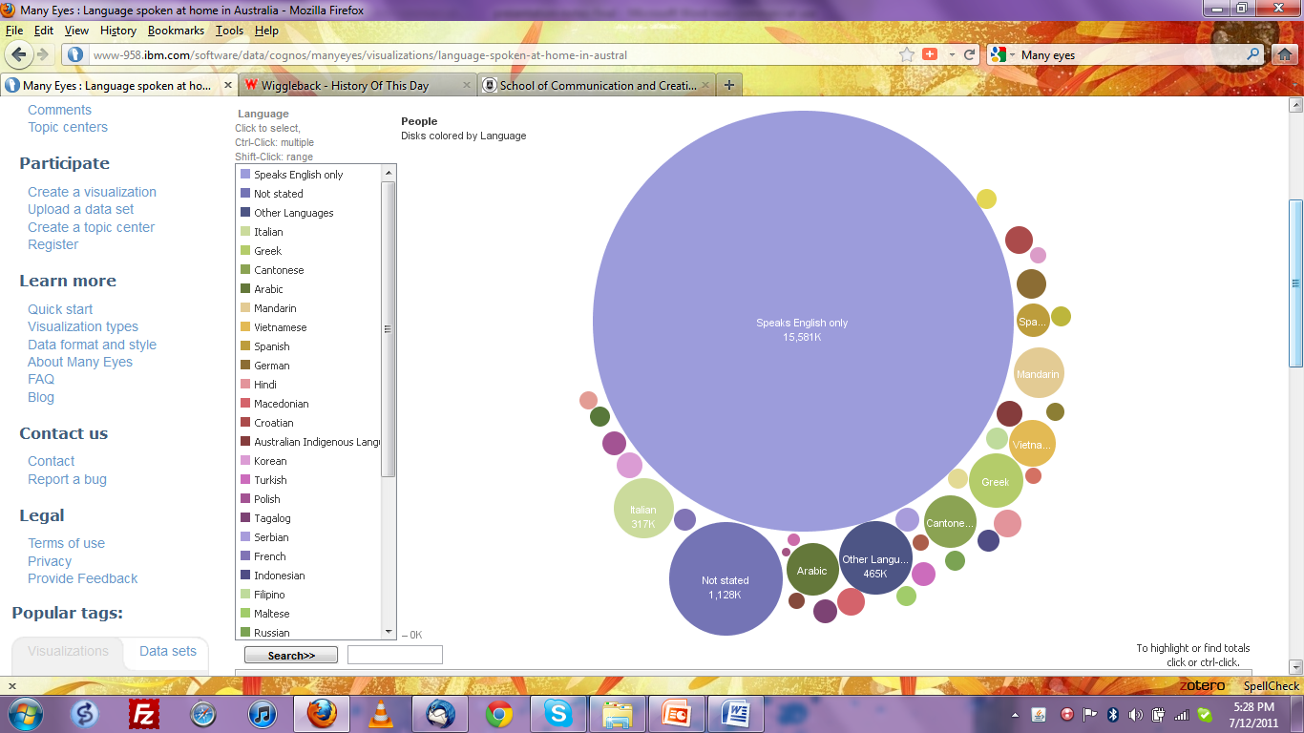

Slide 19
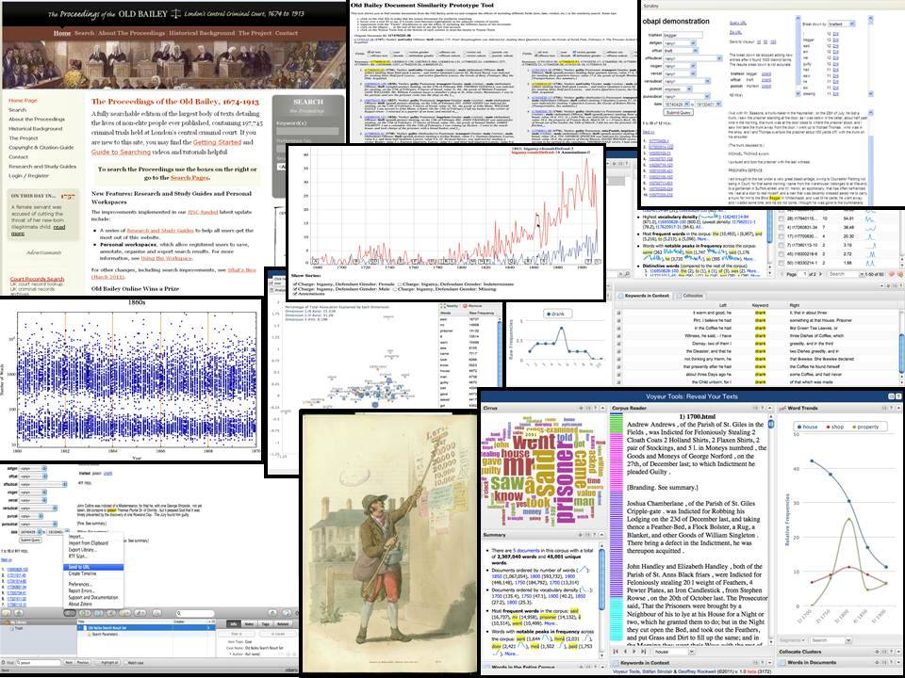

Slide 20
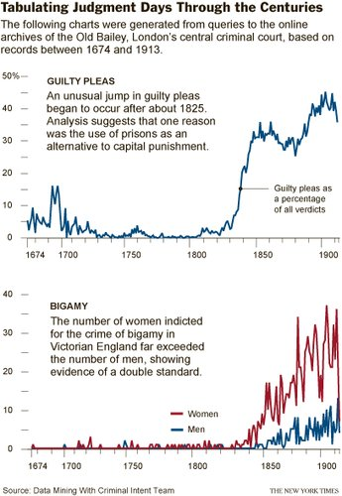

Slide 21

http://www.guardian.co.uk/uk/interactive/2011/dec/07/london-riots-twitter

Slide 22
Use creates significance...
We are at a time of experimentation (lots of different standards and approaches to using data) (make data available in the most useable way possible).
Data document’s better than ‘published’ PDFs etc. (they are OK if it is just one individual reader, but often we need a computer to read and manipulate data for new types of research)
Individual approaches (ie. ‘focussed systems’) often easier to use than broader approaches

Slide 23
Closing comments: Old data in new bottles?
Unless data is discoverable and usable; there is little reason that it should be online as it can’t be built upon and advanced
Use of Data helps sustainability (many barriers to open access)
People create ‘significance’ through turning data into knowledge and wisdom...(many epistemological issues; quantitative research etc.)

Slide 24
Questions?

